Slide 1


Applied Data Science Capstone Project
SPACE X FALCON 9 PREDICTIVE ANALYSIS
DORCUS KYAMBI KIOKO
JULY, 2025

Slide 2
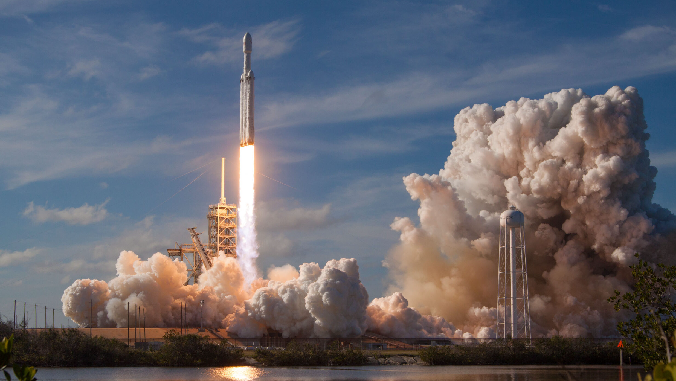
OUTLINE
Executive Summary
Introduction
Methodology
Results
Discussion
Conclusion

Slide 3
Outline
EXECUTIVE SUMMARY
The project aims to predict the success of SpaceX Falcon 9 first stage landings using classification algorithms.
Key steps include:
Collecting, cleaning, and formatting data
Performing exploratory data analysis
Creating interactive visualizations
Applying machine learning models
Analysis shows some launch features are linked to landing success or failure.
The decision tree algorithm appears to be the most effective for making these predictions.

Slide 4
Outline
INTRODUCTION
The goal is to predict whether the Falcon 9 first stage will successfully land.
SpaceX offers launches at $62 million—much cheaper than competitors—largely due to reusing the first stage.
Predicting landing success helps estimate launch costs.
This information can assist other companies in competing with SpaceX.
Many failed landings are intentional, including controlled ocean landings.
The key question is: Based on launch features (like payload mass, orbit, and site), can we predict a successful first-stage landing?

Slide 5
Outline
METHODOLOGY
The methodology requires a few steps essential in data science which includes:
Data collection, wrangling, and formatting, using:
SpaceX API
Web scraping
Exploratory data analysis (EDA), using:
Pandas and NumPy
SQL
Data visualization, using:
Matplotlib and Seaborn
Folium
Dash
Machine learning prediction, using
Logistic regression
Support vector machine (SVM)
Decision tree
K-nearest neighbors (KNN)

Slide 6
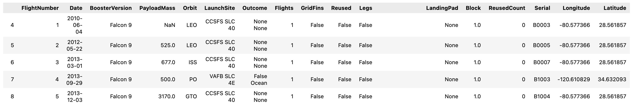
Outline
METHODOLOGY
Data collection, wrangling, and formatting
1
We will use SpaceX API
Data was collected using the SpaceX API: https://api.spacexdata.com/v4/rockets/.
Since the API includes information on various rocket launches, the data was filtered to include only Falcon 9 missions.
Any missing values were filled in using the mean of their respective columns.
The final dataset consists of 90 records and 17 features. The image below displays a sample of the data.

Slide 7

Outline
METHODOLOGY
Data collection, wrangling, and formatting
1
Web scraping
The data is scraped from https://en.wikipedia.org/w/index.php?title=List_of_Falcon_9_and_Falcon_Heavy_launches&oldid=1027686922
The website contains only the data about Falcon 9 launches.
We end up with 121 rows or instances and 11 columns or features. The picture below shows the first few rows of the data:

Slide 8
Outline
METHODOLOGY
Data collection, wrangling, and formatting
1
Data cleaning includes:
eliminating missing value
Removing duplicates
Replacing NAN values
The dataset is further pre processed to ensure categorical variables are converted using one-hot encoding.
A new column named ‘Class’ is added, where 0 indicates a failed launch and 1 indicates a successful one.
After processing, the final dataset contains 90 records and 83 features.

Slide 9



Outline
METHODOLOGY
Exploratory Data Analysis (EDA)
2
Pandas and NumPy Pandas and NumPy functions are used to extract key insights from the dataset, including:
The count of launches per launch site
The frequency of each orbit type
The number and frequency of different mission outcomes
SQL SQL queries are applied to the data to answer questions such as:
What are the unique launch site names used in the missions?
What is the total payload mass carried by NASA (CRS) boosters?
What is the average payload mass for booster version F9 v1.1?

Slide 10



Outline
METHODOLOGY
Data Visualization
3
The Matplotlib and Seaborn libraries are utilized to create various visualizations, including scatter plots, bar graphs, and line charts. These visual tools help explore and analyze relationships between different features, such as:
How flight number correlates with the launch site
The connection between payload mass and launch site
The success rate in relation to orbit type
The Folium library is employed to generate interactive map visualizations. It is used to:
Pinpoint all launch sites on a map
Indicate successful and failed launches at each location
Show the distances from launch sites to nearby landmarks, such as the closest city, railway, or highway

Slide 11

Outline
METHODOLOGY
Data Visualization
3
Plotly Dash
Dash was used to generate an interactive site where we can toggle the input using a dropdown menu and a range slider.
Using a pie chart and a scatterplot, the interactive site shows:
The total success launches from each launch site
The correlation between payload mass and mission outcome (success or failure) for each launch site

Slide 12

Outline
METHODOLOGY
Machine Learning Prediction
4
Scikit-learn library was used to create our machine learning models.
The machine learning prediction steps:
Standardizing the data
Splitting the data into training and test data
Creating machine learning models, which include:
Logistic regression
Support vector machine (SVM)
Decision tree
K nearest neighbors (KNN)
Fit the models on the training set
Find the best combination of hyperparameters for each model
Evaluate the models based on:
accuracy scores
confusion matrix

Slide 13
Outline
RESULTS
The results sections include:
SQL (EDA with SQL)
Matplotlib and Seaborn (EDA with Visualization)
Folium
Dash
Predictive Analysis
NOTE, for categorical data
class 0- failed launch outcome
class 1 -successful launch outcome.

Slide 14
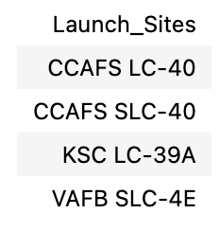
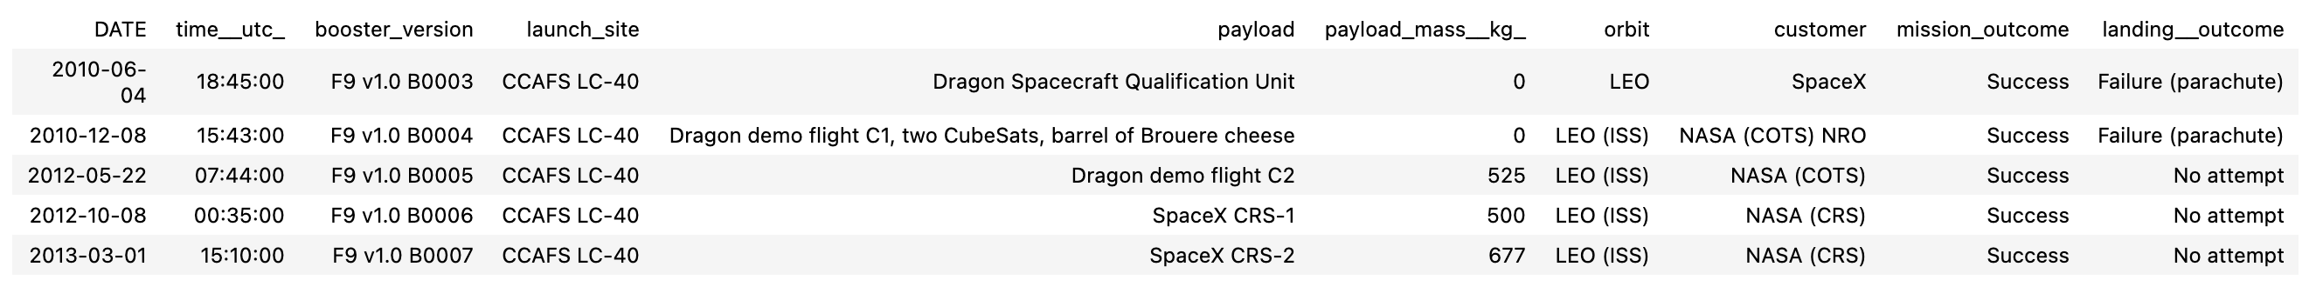
Outline
RESULTS
SQL (EDA with SQL)
1
The unique launch sites were:
5 launch sites that begin with ‘CCA’

Slide 15
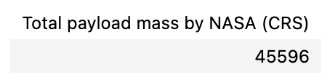
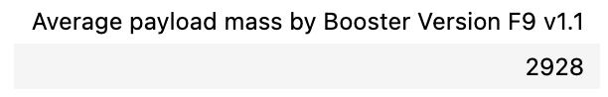
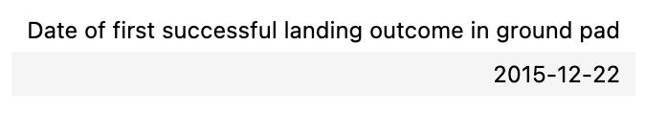
Outline
RESULTS
SQL (EDA with SQL)
1
The total payload mass carried by boosters launched by NASA (CRS)
The average payload mass carried by booster version F9 v1.1
The date when the first successful landing outcome in ground pad was achieved

Slide 16
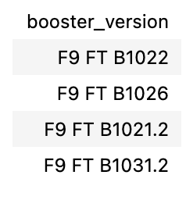
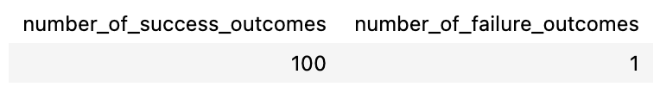
Outline
RESULTS
SQL (EDA with SQL)
1
The names of the boosters which have success in drone ship and have payload mass greater than 4000 but less than 6000
The total number of successful and failure mission outcomes

Slide 17
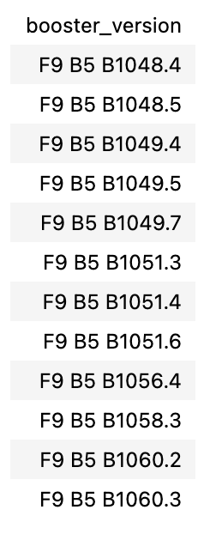
Outline
RESULTS
SQL (EDA with SQL)
1
The names of the booster versions which have carried the maximum payload mass

Slide 18
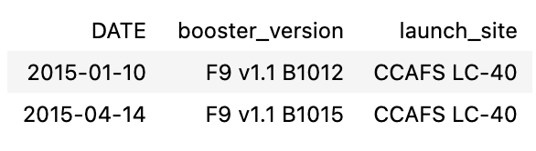
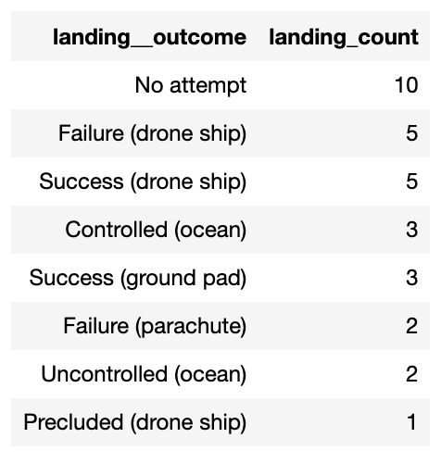
Outline
RESULTS
SQL (EDA with SQL)
1
The failed landing outcomes in drone ship, their booster versions, and launch site names for in year 2015
The count of landing outcomes between the date 2010-06-04 and 2017-03-20, in descending order

Slide 19
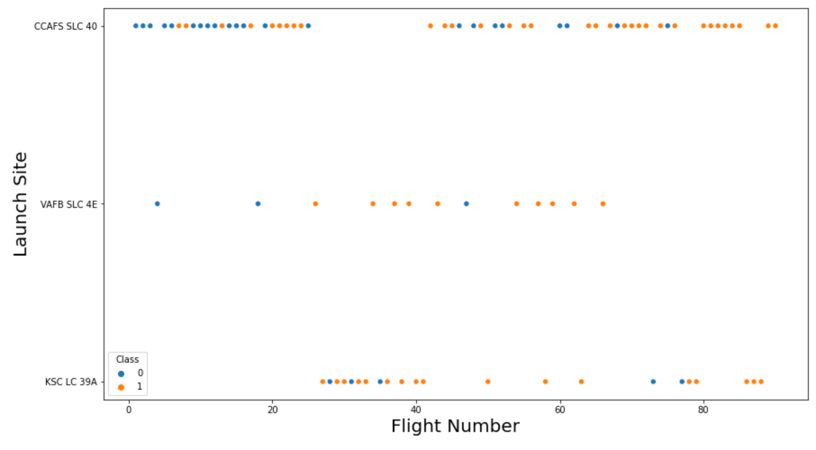
Outline
RESULTS
Matplotlib and Seaborn (EDA with Visualization)
2
A scatter plot relating flight number and launch site

Slide 20
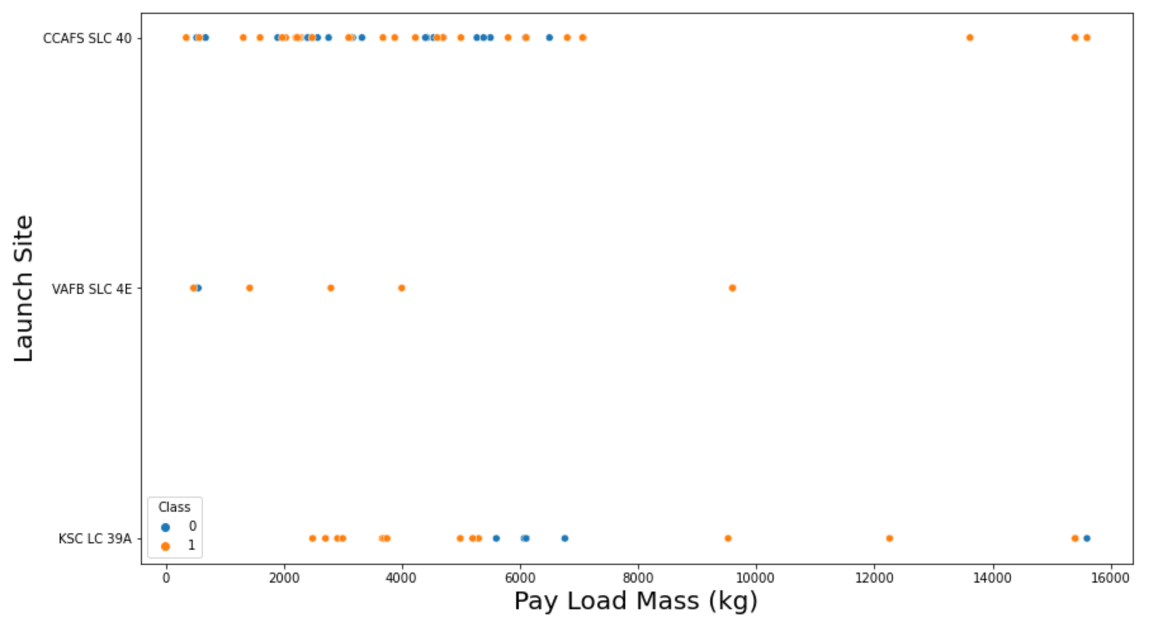
Outline
RESULTS
Matplotlib and Seaborn (EDA with Visualization)
2
The relationship between payload mass and launch site

Slide 21
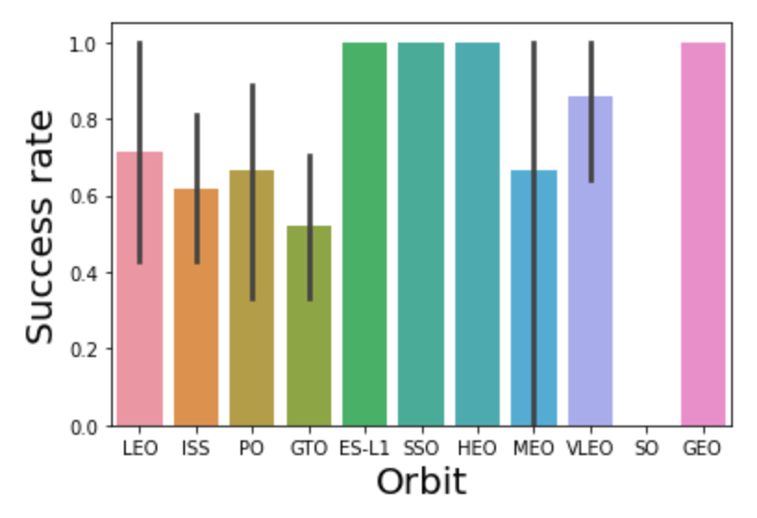
Outline
RESULTS
Matplotlib and Seaborn (EDA with Visualization)
2
Bar chart shows success rate against orbit type

Slide 22
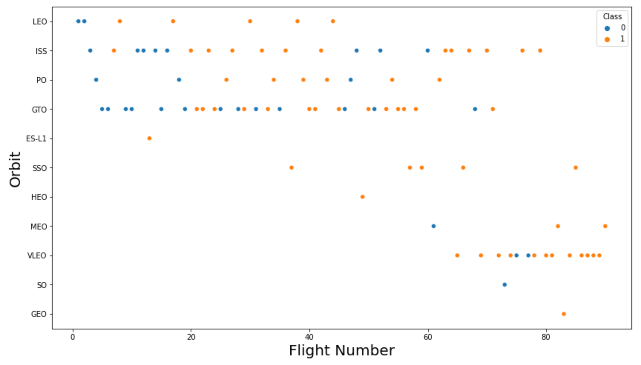
Outline
RESULTS
Matplotlib and Seaborn (EDA with Visualization)
2
The relationship between flight number and orbit type

Slide 23
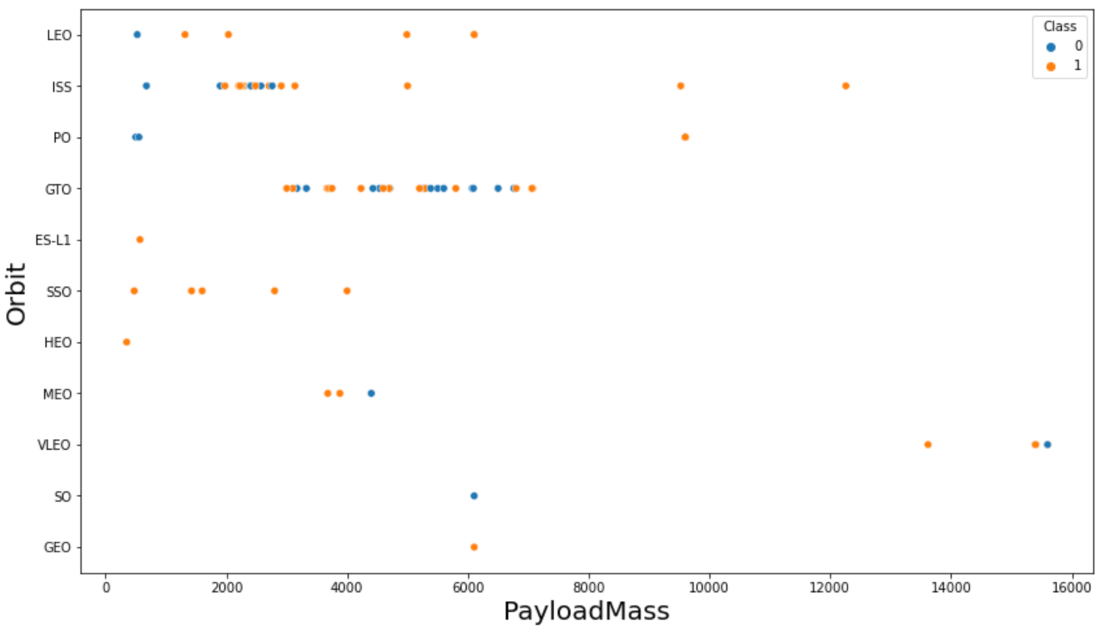
Outline
RESULTS
Matplotlib and Seaborn (EDA with Visualization)
2
The relationship between payload mass and orbit type

Slide 24
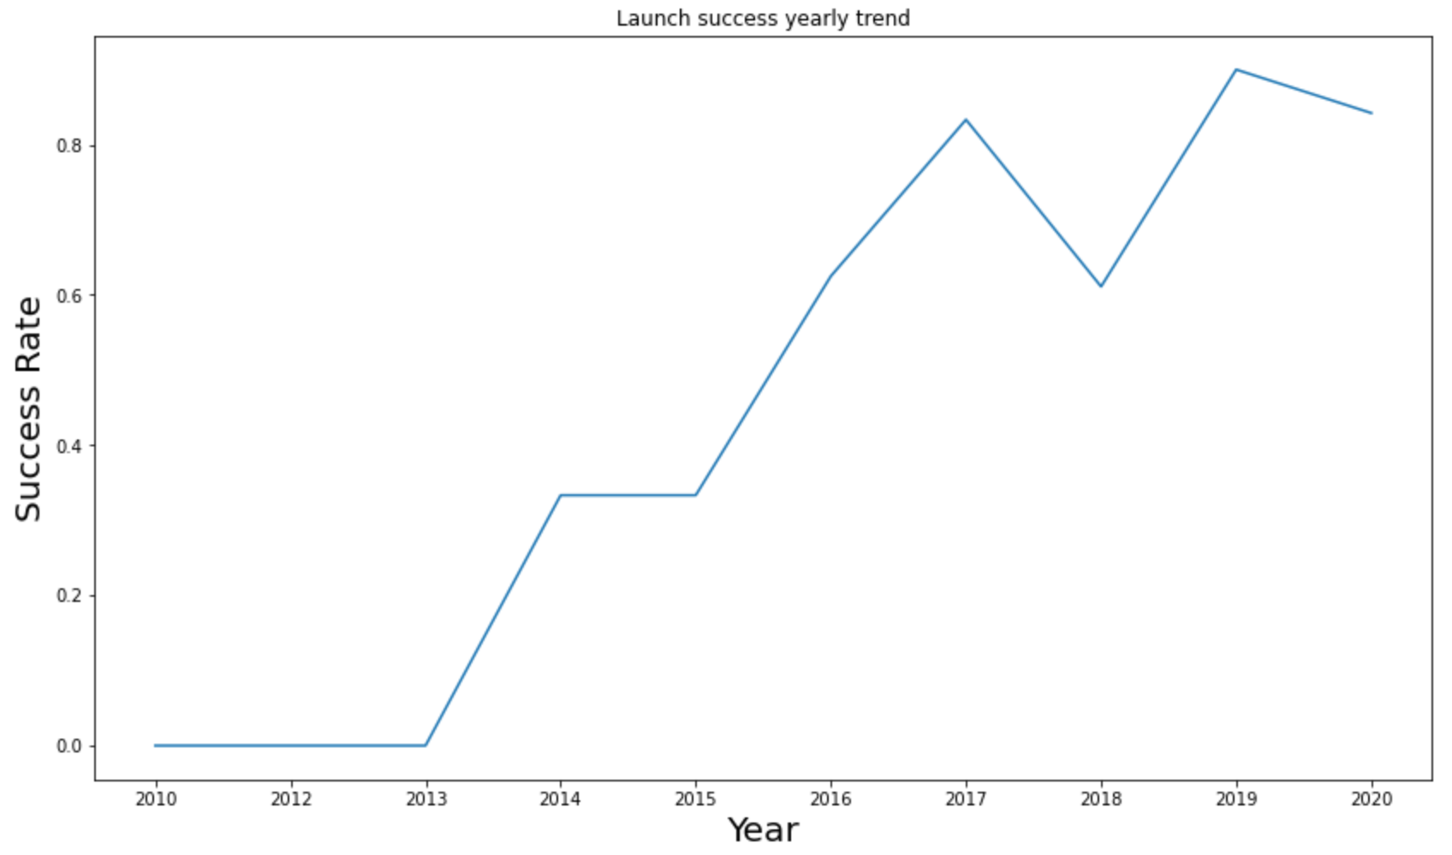
Outline
RESULTS
Matplotlib and Seaborn (EDA with Visualization)
2
The trend of successful launches

Slide 25

Outline
RESULTS
Folium
3
Launch sites locations visuals

Slide 26
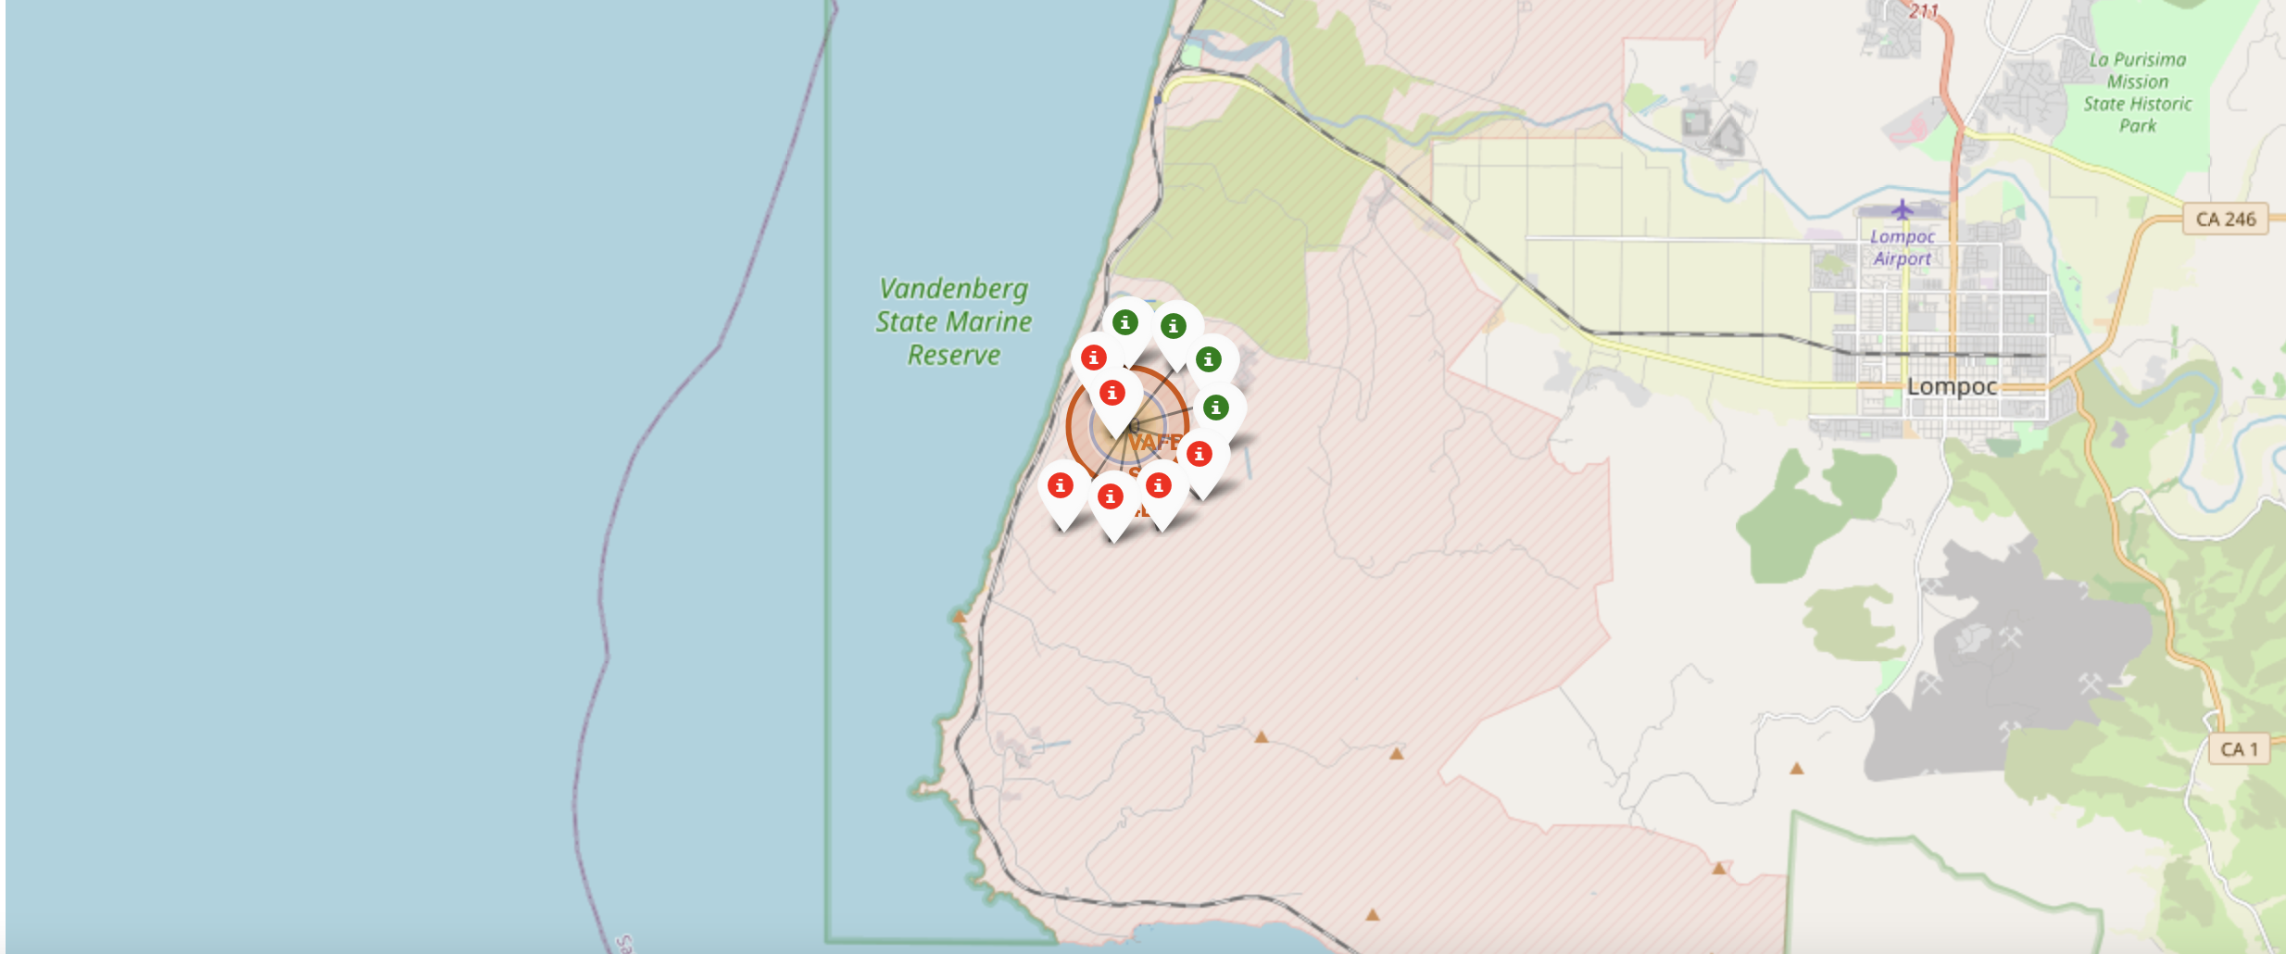
Outline
RESULTS
Folium
3
The successful launches and failed launches for each site on map
Use the zoom feature to expand on see green and red tags.
Each green tag represents a successful launch while each red tag represents a failed launch

Slide 27
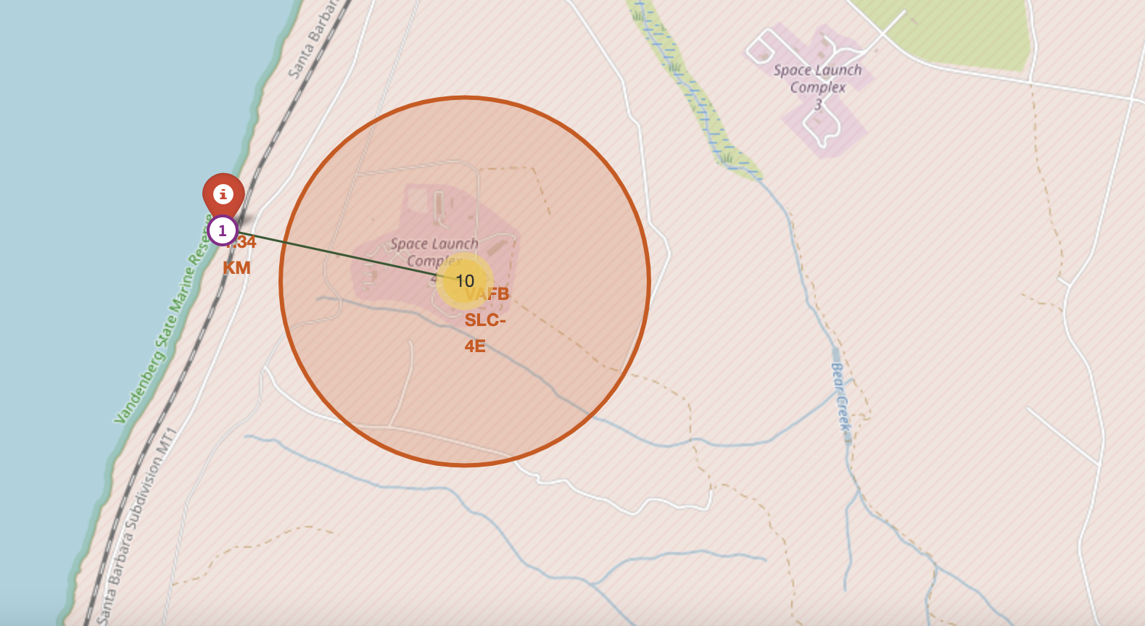
Outline
RESULTS
Folium
3
We can see a launch site to its proximities to the nearest city, railway, or highway
The picture below shows the distance between the VAFB SLC-4E launch site and the nearest coastline

Slide 28

Outline
RESULTS
Dash
4
The picture below shows a pie chart when launch site CCAFS LC-40 is chosen.
0 represents failed launches while 1 represents successful launches. We can see that 73.1% of launches done at CCAFS LC-40 are failed launches.

Slide 29
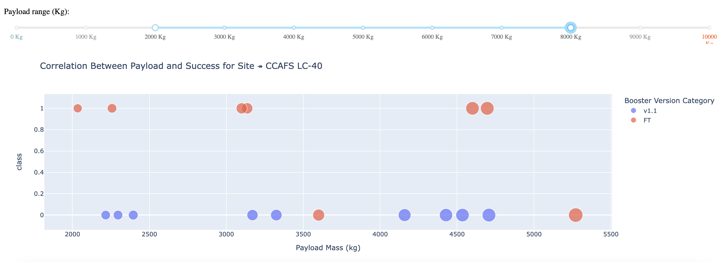
Outline
RESULTS
Dash
4
a scatterplot when the payload mass range is set to be from 2000kg to 8000kg.
Class 0- failed launches while
class 1- successful launches.

Slide 30

Outline
RESULTS
Predictive Analysis
5
Logistic regression Analysis
GridSearchCV best score: 0.8464285714285713
Accuracy score on test set: 0.8333333333333334
Confusion matrix:

Slide 31
Outline
RESULTS
Predictive Analysis
5
Support vector machine (SVM)
GridSearchCV best score: 0.8482142857142856
Accuracy score on test set: 0.8333333333333334
Confusion matrix:

Slide 32
Outline
RESULTS
Predictive Analysis
5
Decision tree
GridSearchCV best score: 0.8892857142857142
Accuracy score on test set: 0.8333333333333334
Confusion matrix:

Slide 33
Outline
RESULTS
Predictive Analysis
5
K nearest neighbors (KNN)
GridSearchCV best score: 0.8482142857142858
Accuracy score on test set: 0.8333333333333334
Confusion matrix:

Slide 34
Outline
RESULTS DISCUSSION
Predictive Analysis
5
Model Comparison Results:
All four models produced the same accuracy score and confusion matrix on the test set.
Therefore, GridSearchCV best scores were used to rank the models.
Model Rankings (based on GridSearchCV best scores):
Decision tree (GridSearchCV best score: 0.8892857142857142)
K nearest neighbors, KNN (GridSearchCV best score: 0.8482142857142858)
Support vector machine, SVM (GridSearchCV best score: 0.8482142857142856)
Logistic regression (GridSearchCV best score: 0.8464285714285713)

Slide 35
Outline
DISCUSSION
Some features appear to correlate with mission outcomes.
Heavier payloads show higher success rates for orbit types like Polar, LEO, and ISS.
For GTO orbits, success and failure rates are mixed, making it harder to draw conclusions.
Each feature may influence mission outcomes differently.
The exact impact of each feature is complex and not easily understood.
Machine learning algorithms can be used to identify patterns in historical data.
These models can help predict mission success based on the input features.

Slide 36
Outline
CONCLUSION
In this project, we predicted if the first stage of a given Falcon 9 launch will land in order to determine the cost of a launch.
Each feature of a Falcon 9 launch, such as its payload mass or orbit type, may affect the mission outcome in a certain way.
Several machine learning algorithms were employed to learn the patterns of past Falcon 9 launch data to produce predictive models that can be used to predict the outcome of a Falcon 9 launch.
The predictive model produced by decision tree algorithm performed the best among the 4 machine learning algorithms employed.

Slide 37
RECOMMENDATIONS
By analyzing historical Falcon 9 launch data, we built predictive models to estimate landing success—critical for cost assessment.
The decision tree algorithm outperformed others, providing the most reliable predictions.
This project demonstrates that data science can optimize aerospace operations, offering competitive insights for the space industry especially on operational cost implications.

